Slide 1
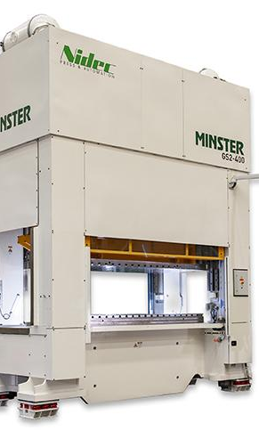
Analyzing Machine Downtime Group:- 7
Miloni Patel : 0788500
Miren Patel : 0782036
Nirmit Pareliya : 0785084
Zeel Mendpara : 0790824
Harsh Patel: 0791820

Slide 2

Contents
Introduction
Problem Statement
Objective
Dataset
Exploratory Data Analysis
Machine Learning Method
Dashboard

Slide 3
What Is Machine Downtime?
Machine downtime occurs when a machine or equipment is unavailable for use due to maintenance, breakdowns, or unforeseen events.
It can have negative effects on productivity, revenue, and customer satisfaction.
Organizations need to track and analyze downtime data to identify causes and improve efficiency.

Slide 4
Problem Statement
The problem statement for our project is to address the issue of machine downtime and scrap production in the manufacturing process. It can lead to delays in production and decreased productivity, while scrap production can result in wasted materials and increased costs.

Slide 5
Objective
Our project aims to identify the factors contributing to machine downtime and scrap production and to develop solutions to minimize their occurrence and improve the overall efficiency of the manufacturing process.

Slide 6
Why it is important to reducing Unplanned Machine Downtime?
Increased Productivity:
Reducing machine downtime can improve organizational productivity and output.
Reduced Maintenance Costs:
It can help organizations save on maintenance costs and allocate resources more effectively.
Improved Customer Satisfaction:
Reducing machine downtime can improve customer satisfaction by allowing organizations to meet customer demand and deliver products/services on time.
Increased Profitability:
It can improve customer satisfaction by allowing organizations to meet customer demand and deliver products/services on time.
Improved Safety:
It can improve worker safety by reducing the need for maintenance or repairs, thereby reducing safety risks associated with those activities.

Slide 7
Causes of Machine Downtime
Equipment failure
Maintenance
Operator error
Production scheduling

Slide 8

Workflow
Collect data
Perform ETL
Data preprocessing
Exploratory Data Analysis
Machine Learning Model
Dashboard Creation

Slide 9
Dataset Set Description
The data was provided by our sponsors and was collected Using various IOT devices.
The fundamental data structure used is ShiftWorx. It is a tree structure that is used to represent many things, from the factories themselves down to individual data points tracked by the sensors.

Slide 10
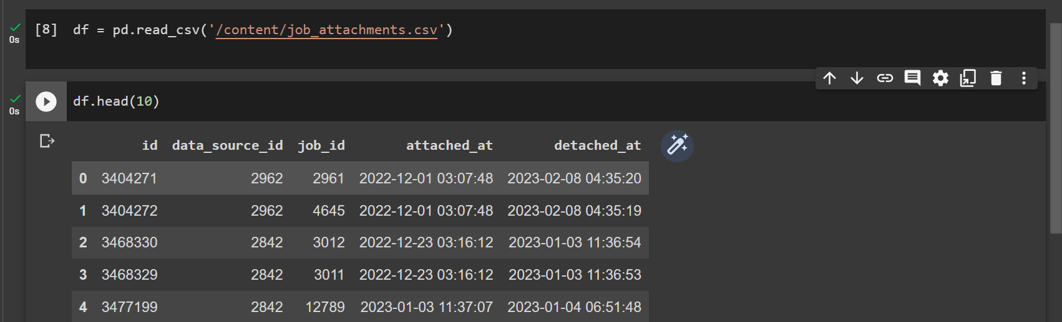
The dataset contains information about machine operations and performance at a factory for two machines i.e. Press 1 and Press 2.
The data is into several tables that describe different aspects of the manufacturing process.
The data represents the information for month of January 2023.

Slide 11
Data Cleaning and Understanding

Slide 12
Why data cleaning is necessary?
Accuracy
Completeness
Standardization
Efficiency

Slide 13
Challenges in actual data
Too many files
Unstructured data
Inappropriate timestamp format

Slide 14
Steps used for clean data:
Perform ETL method(Extract, Transform, Load) in Python to integrate data for computation and analysis
Normalised files using Excel

Slide 15

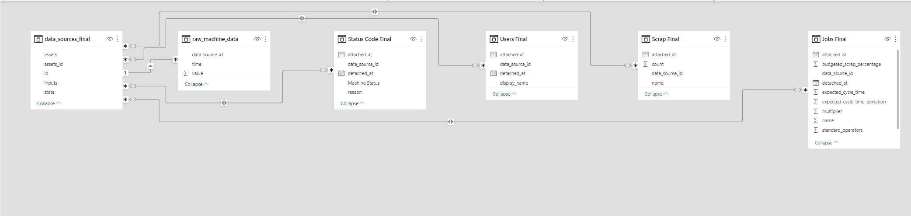
The primary tables in this dataset:
Company and Machine Information
Data Source Attachments
Users
Status Codes
Jobs
Scrap

Slide 16
Exploratory Data Analysis
There are many potential causes of machine downtime, including equipment failure, poor maintenance practices, operator error, and environmental factors such as temperature and humidity.
To analyze machine downtime effectively, it is necessary to identify the specific cause or causes of each incident and track them over time to identify patterns and trends.

Slide 17
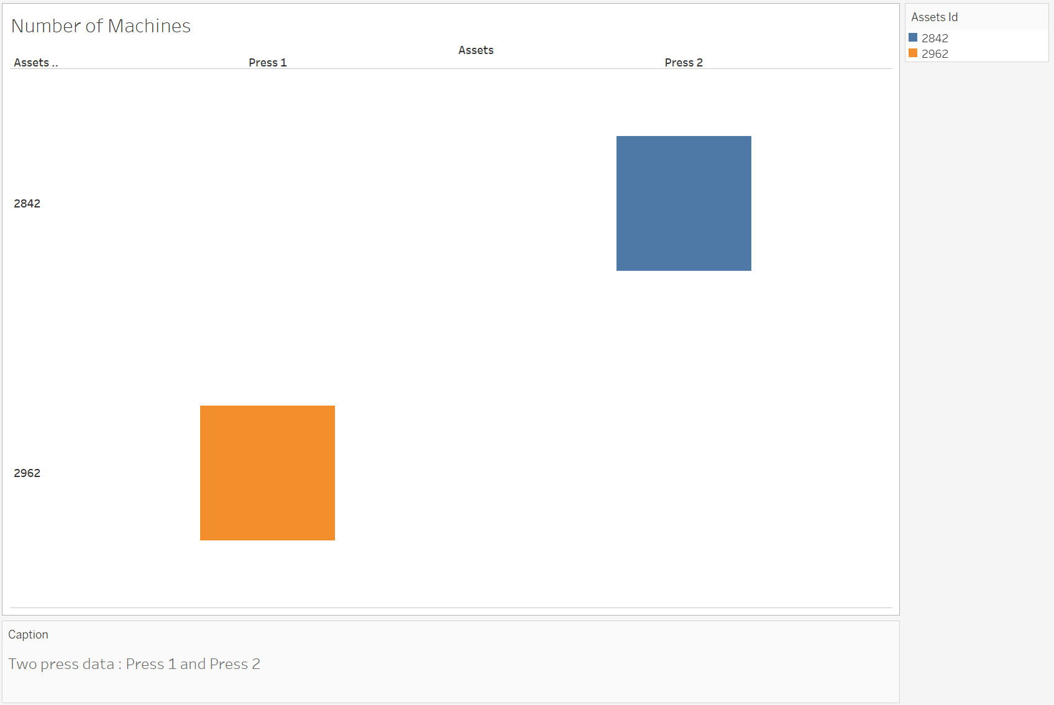
No. of Machines

Slide 18
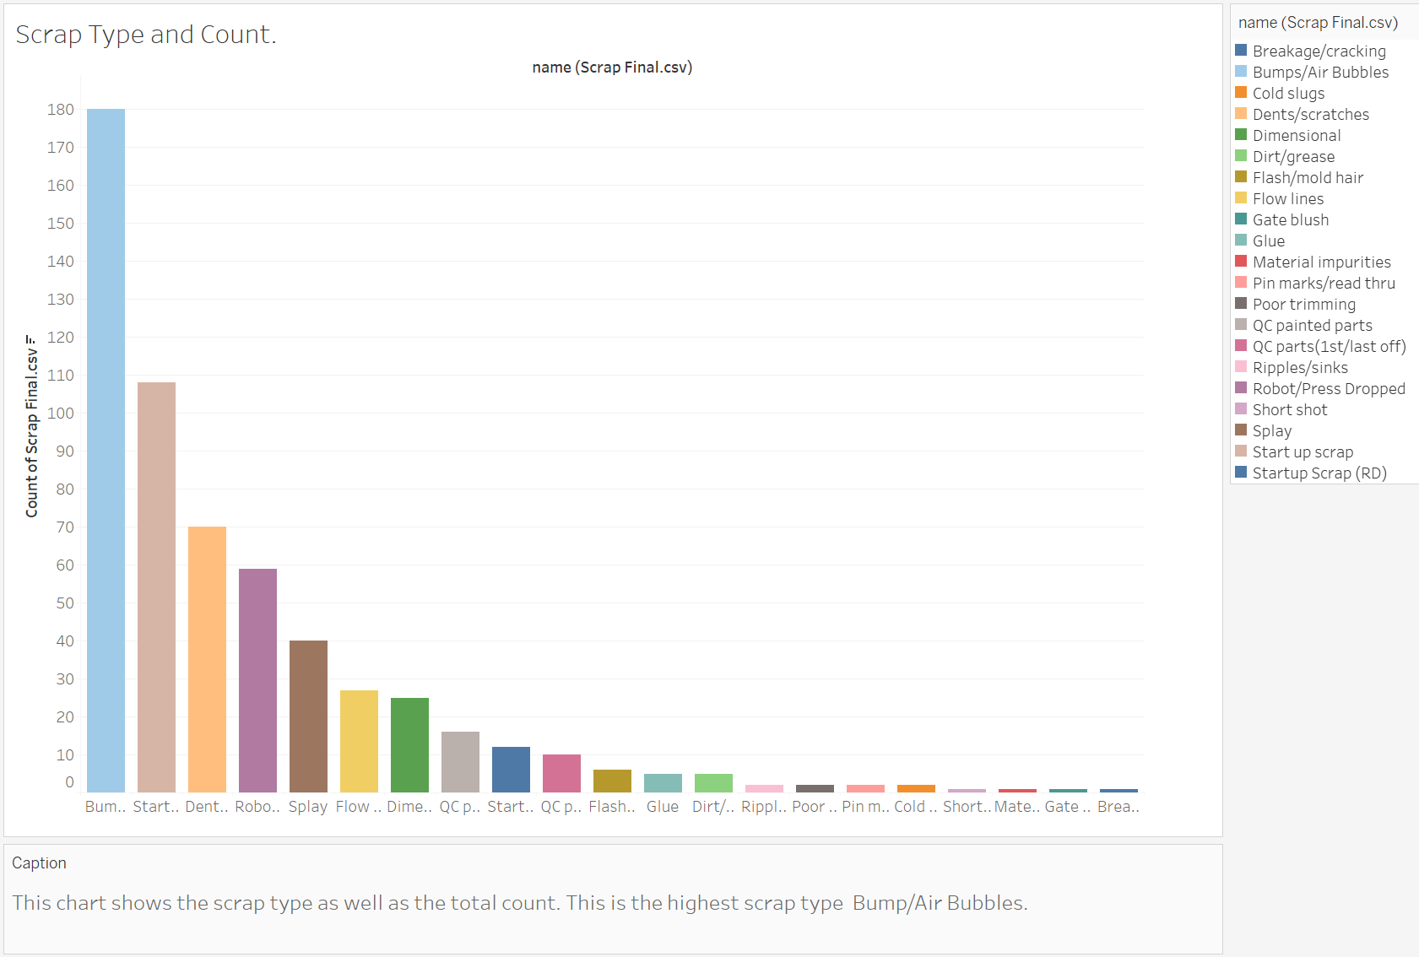
Different types of scrap and their type

Slide 19
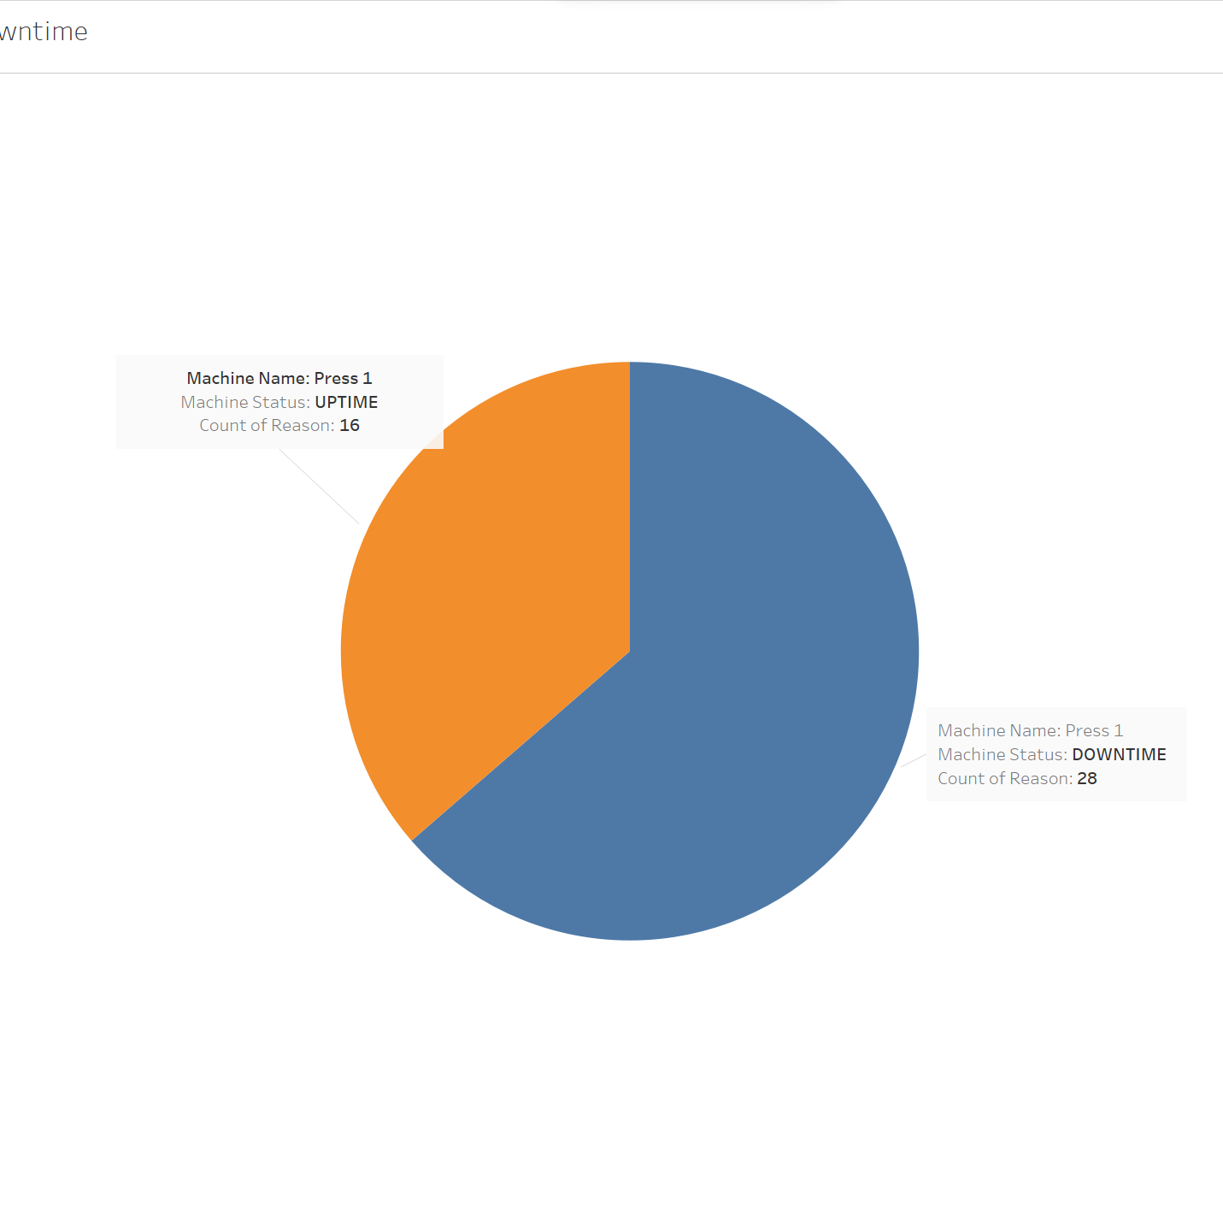
Machine 1 Up and Downtime

Slide 20

Machine 2 Up and Downtime

Slide 21
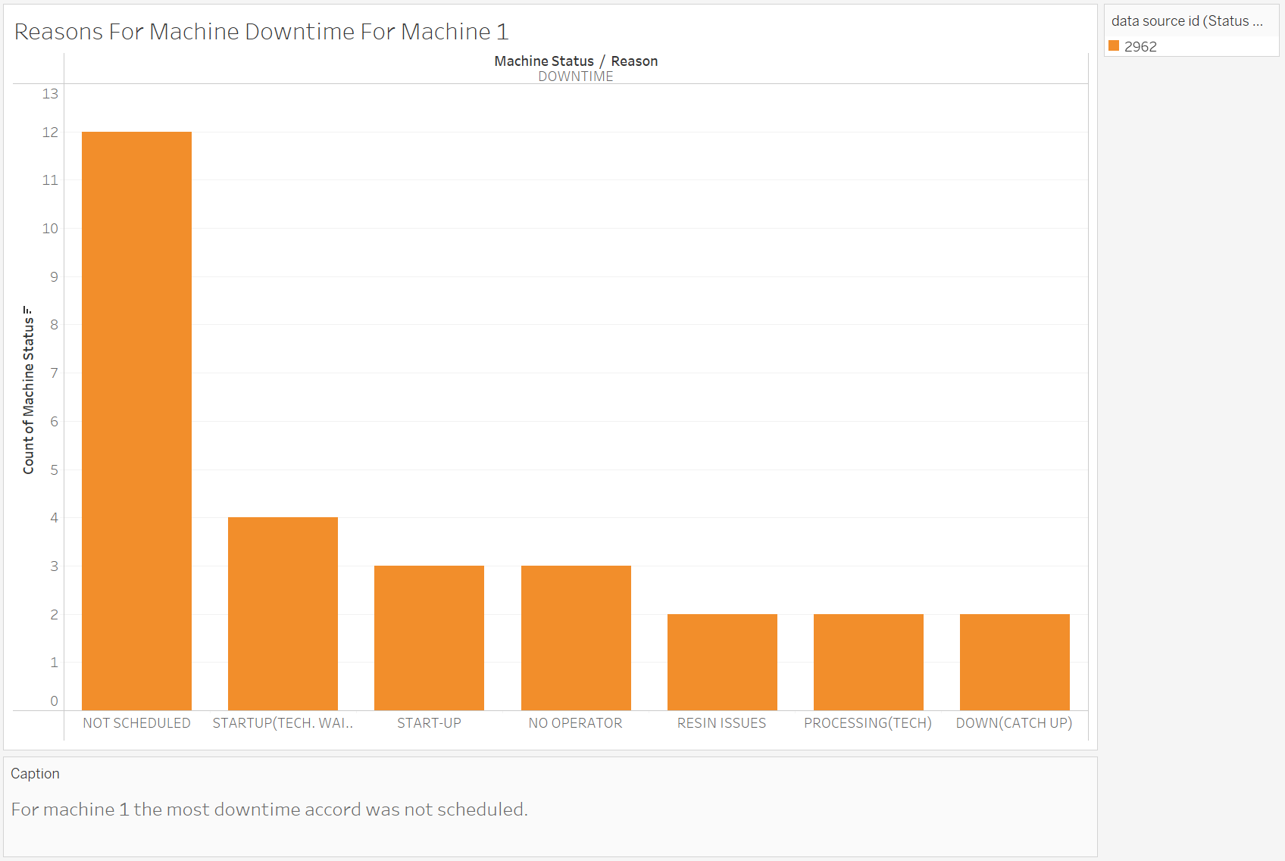
Reasons for Machine 1 downtime

Slide 22
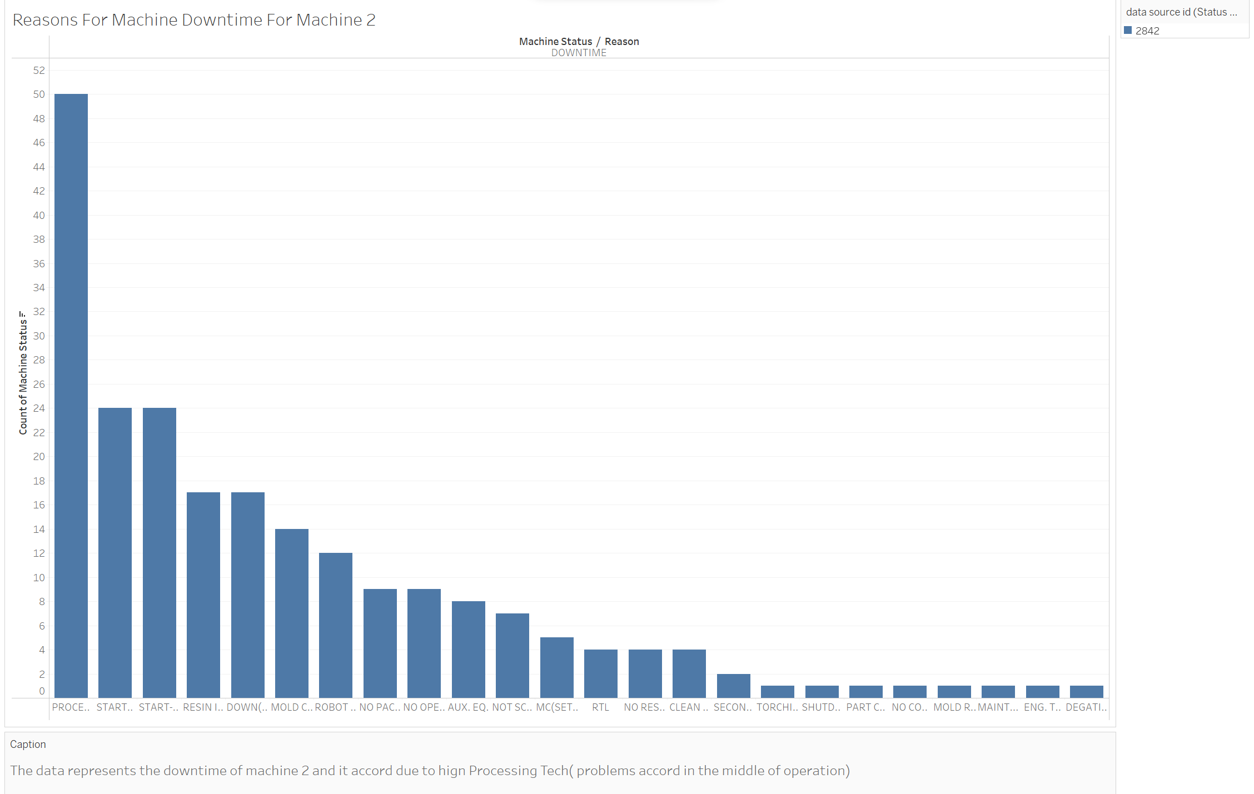
Reason for Machine 2 downtime

Slide 23
Machine Learning Method
Machine Learning method used Logistic regression because it is commonly used for binary classification problems, where the goal is to predict a binary output variable based on one or more input variables.
In this case, the goal is to predict whether a machine is operating normally or not, which is a binary classification problem.
Therefore, logistic regression is a suitable choice for this problem. Additionally, logistic regression is a simple and interpretable model that is often used as a baseline model for classification tasks.

Slide 24
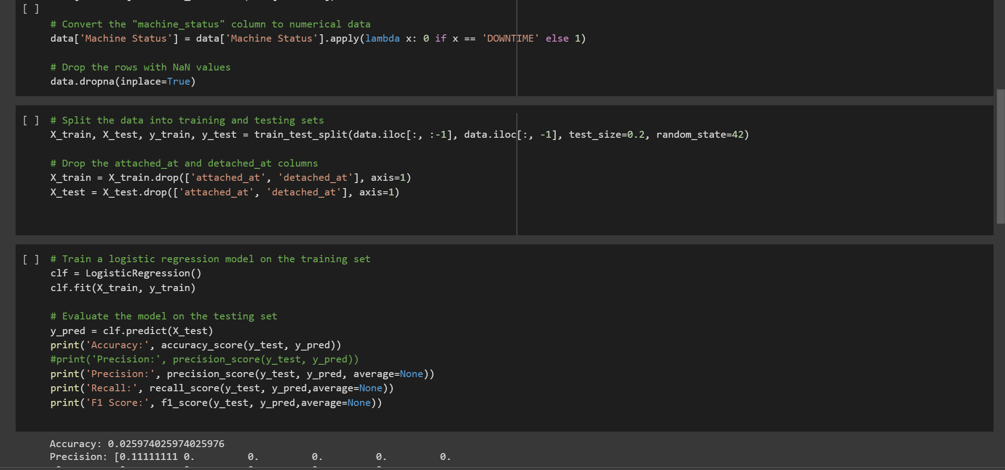
Accuracy Is 0.25%

Slide 25
Limitations
The dataset may not be representative of the true distribution of data as it is biased towards a particular machine i.e. Press 2.
The dataset only spans a single month, which may not capture all the variations and patterns present in the data over a longer period of time.
This limited information may not be enough to capture all the relevant features and factors that could influence the status.
In Summary, to build a more robust and accurate model, a larger and more diverse dataset, with continuous sensor data and additional relevant features, would be needed

Slide 26
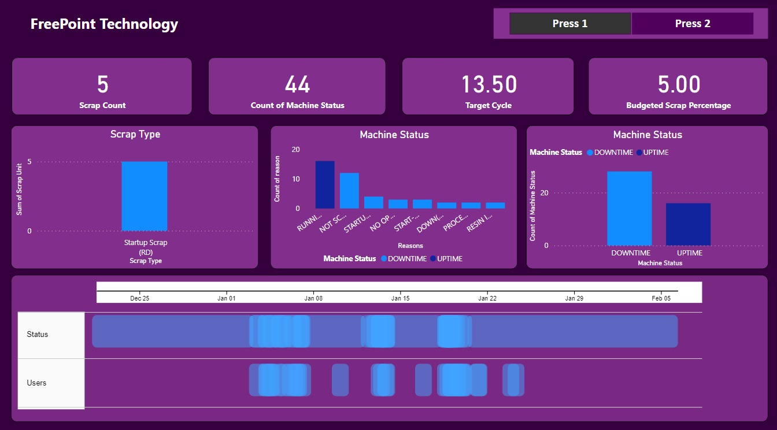
Dashboard

Slide 27
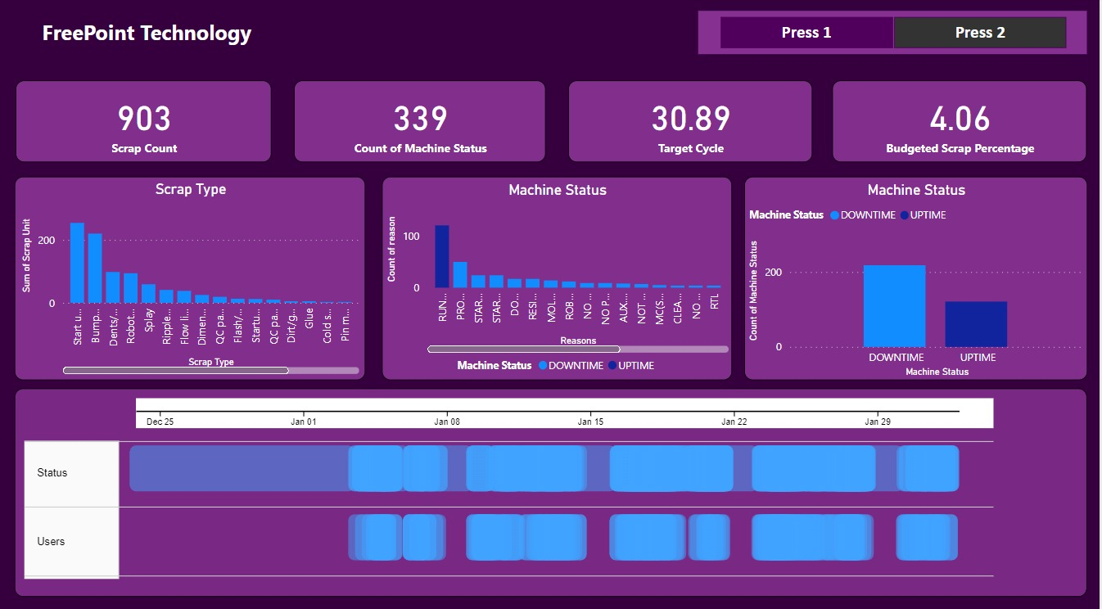
Dashboard

Slide 28
References
https://github.com/mapr-demos/predictive-maintenance/blob/master/notebooks/jupyter/LSTM%20For%20Predictive%20Maintenance-ian01.ipynb
https://rjunaidraza.medium.com/predictive-maintenance-using-machine-learning-lstm-python-373396c6bb82
https://towardsdatascience.com/lstm-for-predictive-maintenance-on-pump-sensor-data-b43486eb3210
https://www.engineering.com/story/how-to-reduce-machining-time-with-3-axis-turning
https://mechmatrix.in/how-to-reduce-cycle-time-without-reducing-tool-life-in-cnc-machining/
https://www.meadenmoore.com/blog/consulting/benefits-of-reducing-machine-setup-time#:~:text=Although%20decreasing%20run%20times%20reduces,flexibility%20to%20meet%20customer%20demands.
https://www.machinemetrics.com/blog/reduce-downtime-manufacturing

Slide 29
Thank You

